Slide 1
Introduction to Pytorch

Slide 2
Background
Open source machine learning library from Meta
One of the largest machine learning
Tensorflow from Google
Primarily used for research
Able to utilize GPU’s for simultaneous calculations
Nvidia’s CUDA

Slide 3
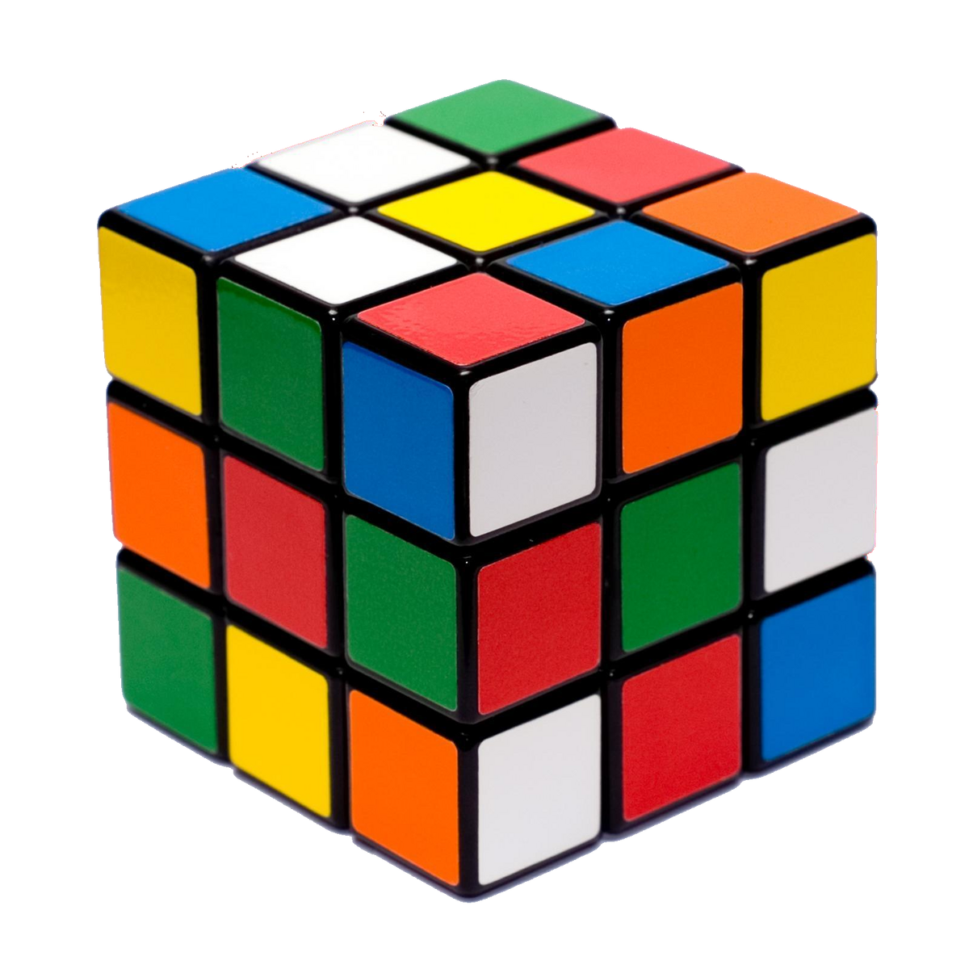
Core Concepts
Tensor
Tensor is an N-dimensional array
Scalar
Vector
Matrix
Notes:
Tensor’s are similar

Slide 4
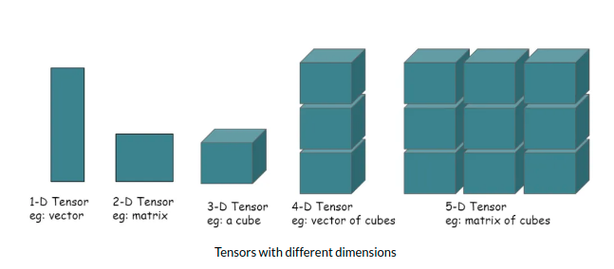
Tensor Examples
3d Tensor:
RGB Picture
Height, Width and Color
4d Tensor:
RGB Video
Height, Width, Color and Time

Slide 5
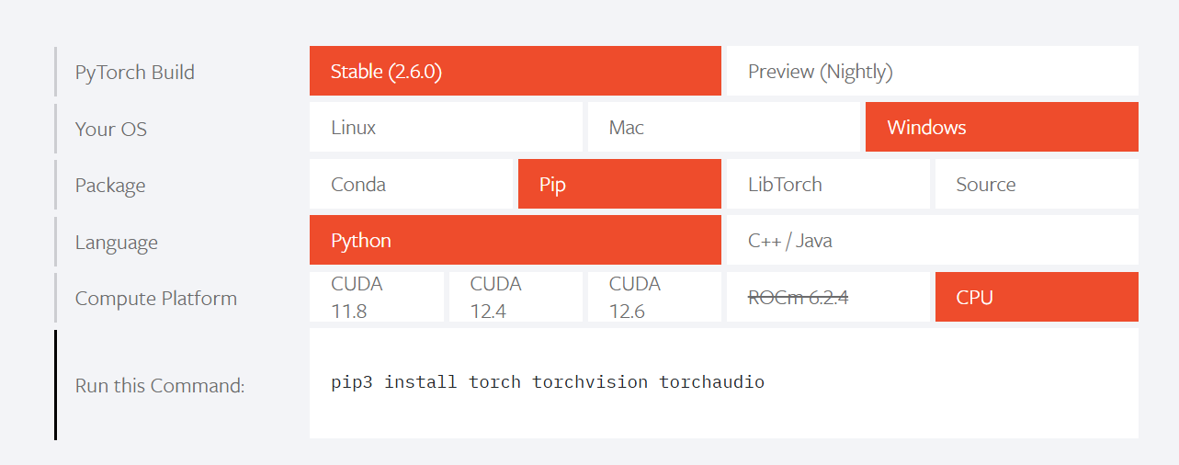
How to Install
Link: PyTorch

Slide 6
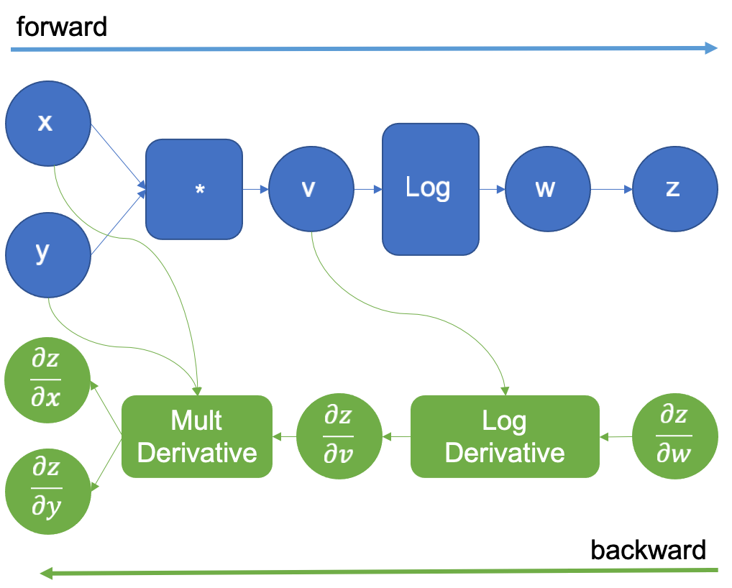
Autograd
Short for automatic differentiation
Gradients
Autograd creates a chart showing how tensors are connected.
Contains leaves and roots.
Forward and backward modes

Slide 7
Bibliography
https://ai.meta.com/tools/pytorch/
https://static.wikia.nocookie.net/speedsolving/images/a/a1/Rubik%27s_Cube_transparency.png/revision/latest/scale-to-width-down/1200?cb=20141018181906
https://media.licdn.com/dms/image/v2/D4D12AQGBWEH55J0srw/article-cover_image-shrink_600_2000/article-cover_image-shrink_600_2000/0/1686308835063?e=2147483647&v=beta&t=unycJxyxEuLjKUY9yoB2P6WgKP8j5-QITqkV9jYln-Y
Autograd mechanics — PyTorch 2.6 documentation

